Slide 1

Analysis of the Effectiveness of the Police Initiative to Reduce Violent Crime Rates in Philadelphia
11.21.24
DSCI 431
By Nicolas Kozachuk

Slide 2
Agenda
DSCI 431 Project Presentation
1.
Problem Description
2.
Dataset Description
3.
Goals
4.
Proposed Methods
5.
Results

Slide 3
Agenda
DSCI 431 Project Presentation
1.
Problem Description
2.
Dataset Description
3.
Goals
4.
Proposed Methods
5.
Results

Slide 4
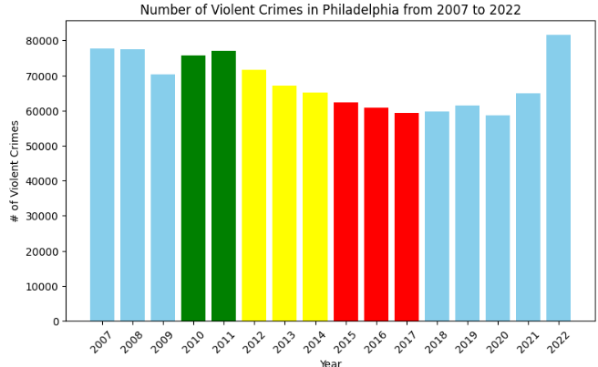

Problem Description
Due to high violent crime rates in the late 2000s, Philadelphia started a smart policing initiative funded by grants by the Bureau of Justice Statistics in order to reduce violent crime rates in hotspot areas.
The Philadelphia Police Department's (PPD) Smart Policing initiative used data-driven strategies to fight crime and make the city safer.
This project will analyze the effectiveness of the smart policing initiative to reduce violent crime overall in Philadelphia, as well as in hot spot areas.

Slide 5
Agenda
DSCI 431 Project Presentation
1.
Problem Description
2.
Dataset Description
3.
Goals
4.
Proposed Methods
5.
Results

Slide 6
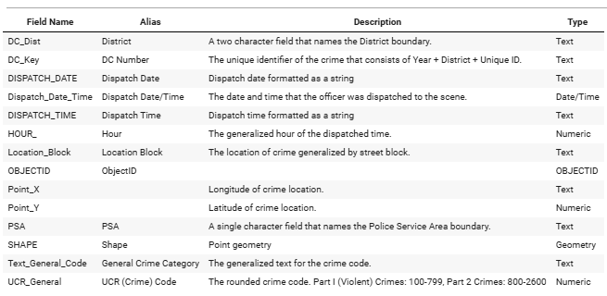
Dataset Description
1,090,720 Violent Crime Instances from 2007-2022
Added features for the year and street location

Slide 7
Agenda
DSCI 431 Project Presentation
1.
Problem Description
2.
Dataset Description
3.
Goals
4.
Proposed Methods
5.
Results

Slide 8

Goals
Determine if the smart policing initiative led to a statistically significant decrease in violent crime rates in Philadelphia overall
Find hotspot areas for violent crime and determine if the smart policing initiative led to a statistically significant decrease in violent crime
Determine if a decrease in violent crime rates are statistically significant using different methods for determining hot spots and using multiple different techniques

Slide 9
Agenda
DSCI 431 Project Presentation
1.
Problem Description
2.
Dataset Description
3.
Goals
4.
Proposed Methods
5.
Results

Slide 10
Proposed Methods
Determining if violent crime rates had a statistically significant decrease due to the policing initiative(2011-2017)
Evaluate whether the overall trend in crime rates in Philadelphia is decreasing in a statistically significantly manner using linear regression
Use Repeated Measures ANOVA(One Way Analysis of Variance) to test whether there are statistically significant differences in violent crime rates across for Philadelphia overall and in hot spot streets
Use the Mann-Kendall test to assess whether there is a significant downward trend for violent crime rates overall and in hot spot areas
The data is non-parametric (does not follow a normal distribution)
Finding hotspot locations
Isolate crimes by street and use z-score thresholds to find streets with highest crime rates
Remove 0s
K-Means clustering to find epicenters for hot spots and z-score thresholds to find radius for crimes
Different clustering counts
Notes:
A repeated measures ANOVA is a statistical technique that compares mean scores across multiple observations of the same subjects. It's used when comparing groups made up of the same type, and is particularly useful in studies where the same participants are observed under different conditions or over time
The Mann-Kendall Test is used to determine whether a time series has a monotonic upward or downward trend.

Slide 11
Agenda
DSCI 431 Project Presentation
1.
Problem Description
2.
Dataset Description
3.
Goals
4.
Proposed Methods
5.
Results

Slide 12
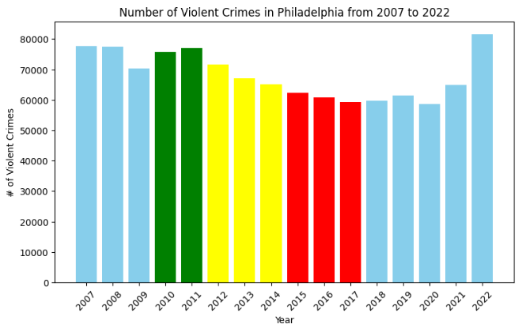
Results - Overall Philadelphia
Linear Regression for Overall Philadelphia
Slope: -2829.536
P-Value: 0.000337
Measured ANOVA for Overall Philadelphia
F-Statistic: 2.507
P-Value: 0.01417
Mann-Kendall Trend Test for Overall Philadelphia
P-Value: 0.0027

Slide 13
Results - Hot Spot Streets
Hot Spot Streets
22,322 Street instances
13,026 Street instances after removing 0s
749 Street instances using z-score = 0.5 threshold
5.75%
Measured ANOVA for Philadelphia Hot Spot Streets
F-Statistic: 2.126
P-Value: 0.0377

Slide 14
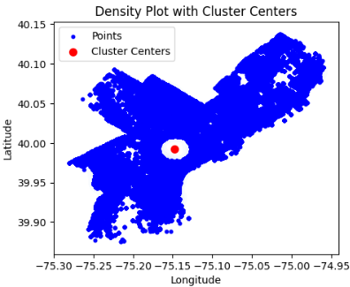
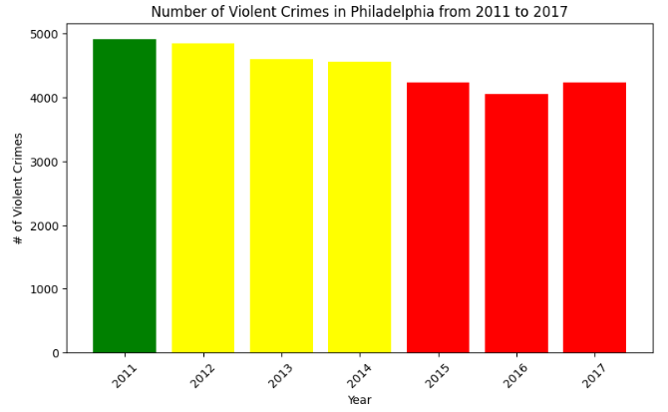
Results - Hot Spot Centers 1
Hot Spot Center Set 1 (1 Center)
Z-value = 1.3
6.82% of total data
Mann-Kendall Trend Test for Center 1
P-Value: 0.0069

Slide 15
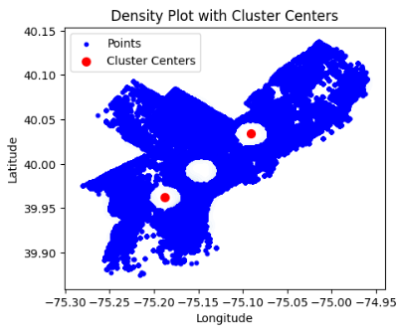
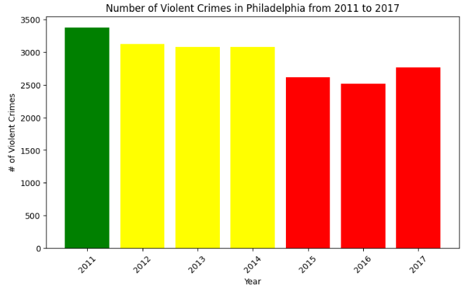
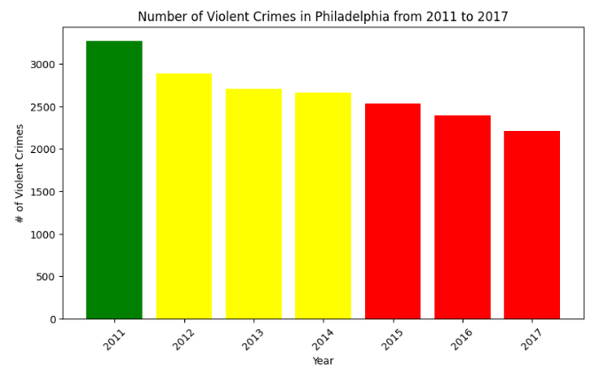
Results - Hot Spot Centers 2
Hot Spot Center Set 2 (2 Centers)
Z-value = 1.15
4.95%, 4.25% of total remaining data
Mann-Kendall Trend Test for Centers Set 2
P-Value 1: 0.0355
P-Value 2: 0.0027

Slide 16
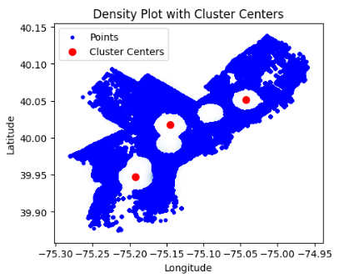
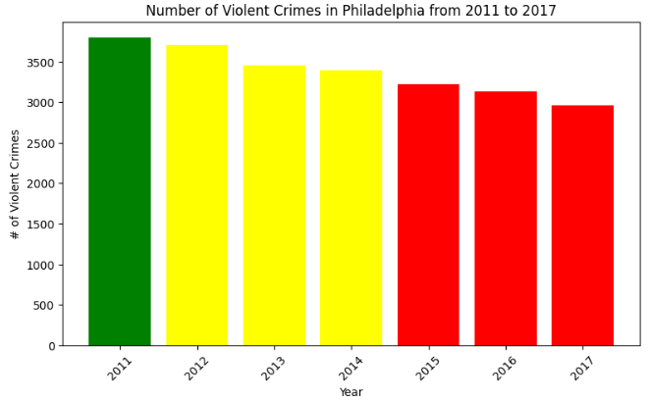
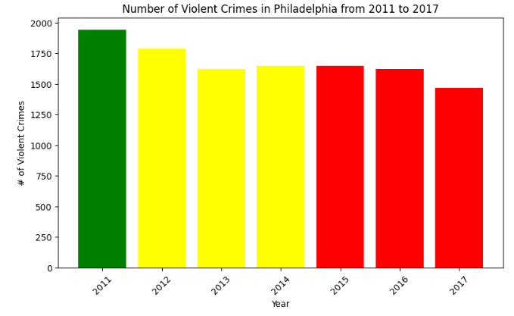
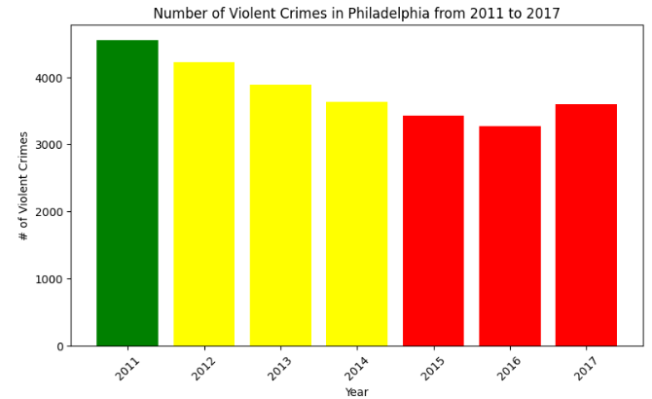
Results - Hot Spot Centers 3
Hot Spot Center Set 3 (3 Centers)
Z-value = 1
6.16%, 2.93%, 7.17% of total remaining data
Mann-Kendall Trend Test for Centers Set 3
P-Value 1: 0.0027
P-Value 2: 0.0355
P-Value 3: 0.0163

Slide 17
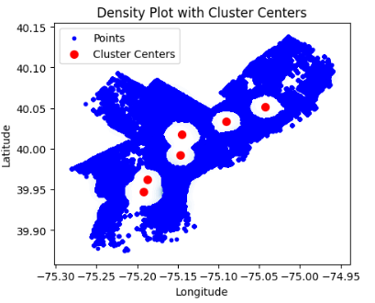
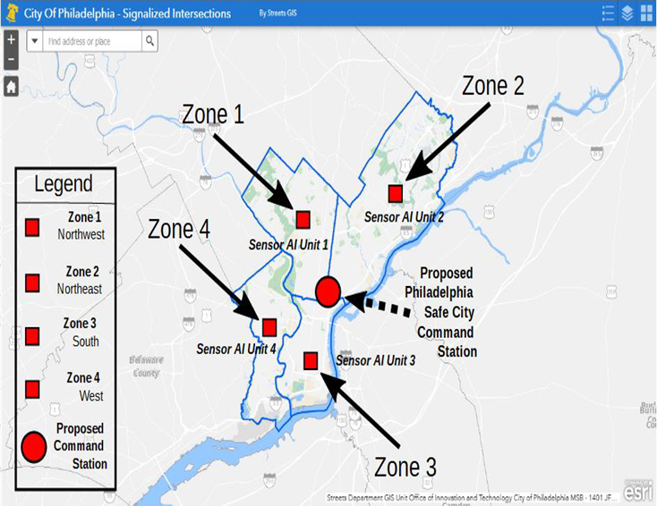
Results - Overall Hot Spot Centers

